Slide 1
Task1: Write an application that counts the number of keywords in a Java source file. If a keyword is in a comment (include line comment or block comment) or in a string, don’t count it. Pass the Java file name from the command line. Assume the Java source code is correct and line comments and paragraph comments do not overlap. Properly handle all the exceptions in the program. You can find list of java keywords on the following link, https://www.w3schools.in/java-tutorial/keywords/
Case | Input | Output | Result
1. Normal case | java ca.jay.jac444.workshop4.W4Task1 test.java | The number of keywords in test.java is 53 | OK
2. Missing command-line argument for file | java ca.jay.jac444.workshop4.W4Task1 | It needs a command-line arguments for a file name | OK
3. command-line argument is not .java file | java ca.jay.jac444.workshop4.W4Task1 test.jsp | The input file is not .java file. | OK
4. File not found | java ca.jay.jac444.workshop4.W4Task1 a.java | It cannot find the file | OK

Slide 2
Test file: test.java
/**********************************************
abstract, assert, boolean, break,
**********************************************/
/*
abstract, assert, boolean, break,
byte, case, catch, char,
volatile, while, true, false,
null
*/
abstract, assert, boolean, break,
byte, case, catch, char,
class, const, continue, default,
do, double, else, enum,
extends, final, finally, float,
for, goto, if, implements,
import, instanceof, int, interface,
long, native, new, package,
private, protected, public, return,
short, static, strictfp, super,
switch, synchronized, this, throw,
throws, transient, try, void,
volatile, while, true, false,
null
// abstract, assert, boolean, break,
// byte, case, catch, char,
"abstract", "assert", "boolean", "break",

Slide 3
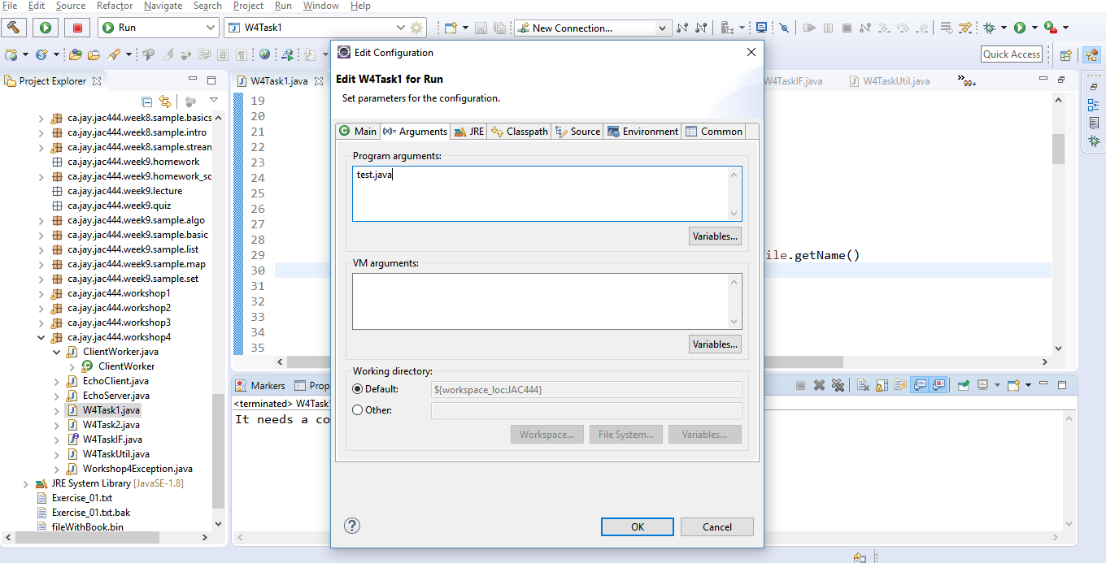
Case1. Normal case:
Set “test.java” in arguments field in IDE tool and run it
(or run “java ca.jay.jac444.workshop4.W4Task1 test.java” in command-line

Slide 4
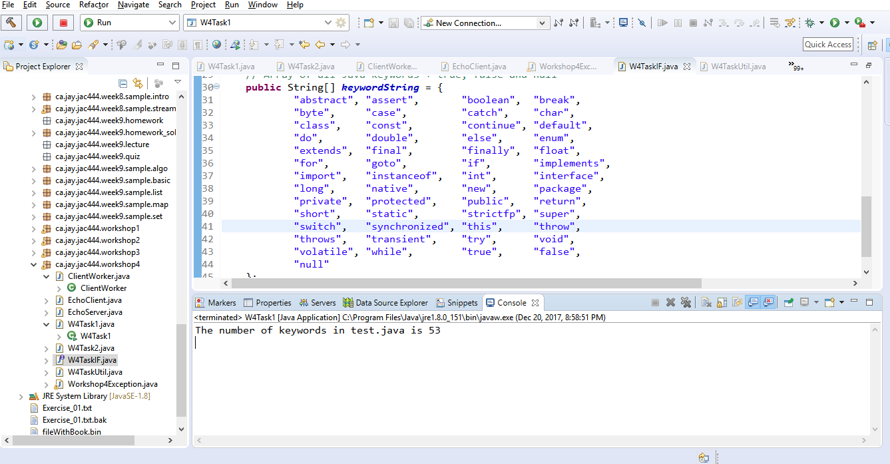
Case1. Normal case:
Check the message: “The number of keywords in test.java is 53”
Normal message is displayed

Slide 5
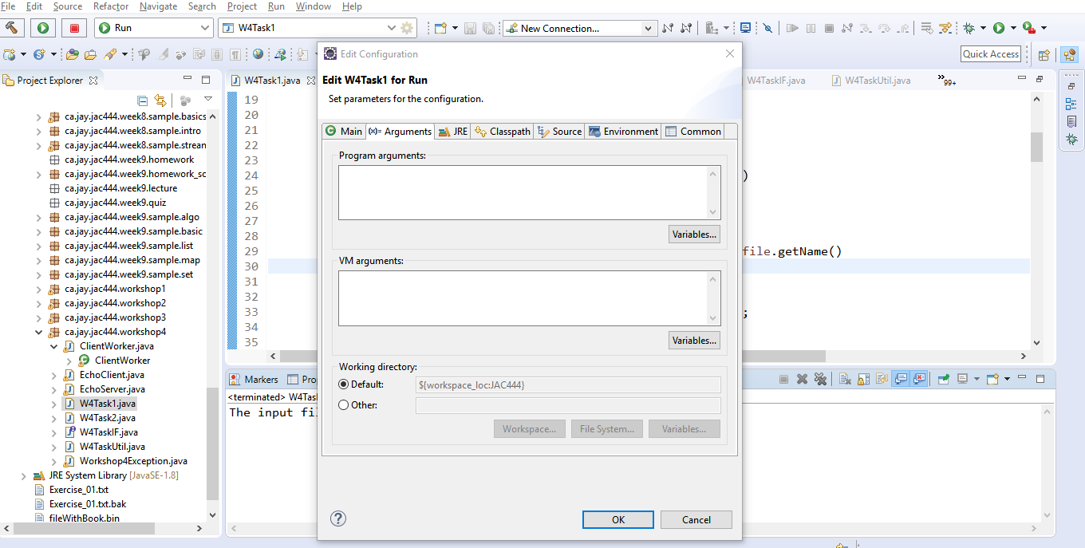
Case2. Missing command-line argument for file:
Set nothing in arguments field in IDE tool and run it
(or run “java ca.jay.jac444.workshop4.W4Task1” in command-line

Slide 6
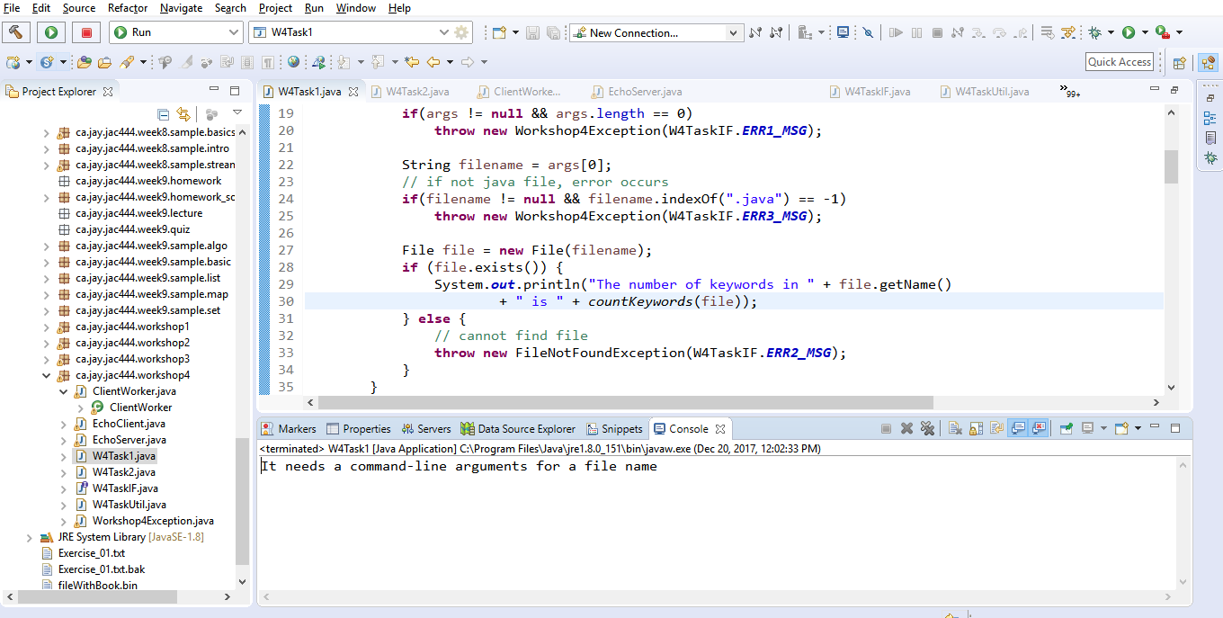
Case2. Missing command-line argument for file:
Check the error message: “It needs a command-line arguments for a file name”
Error message is displayed

Slide 7
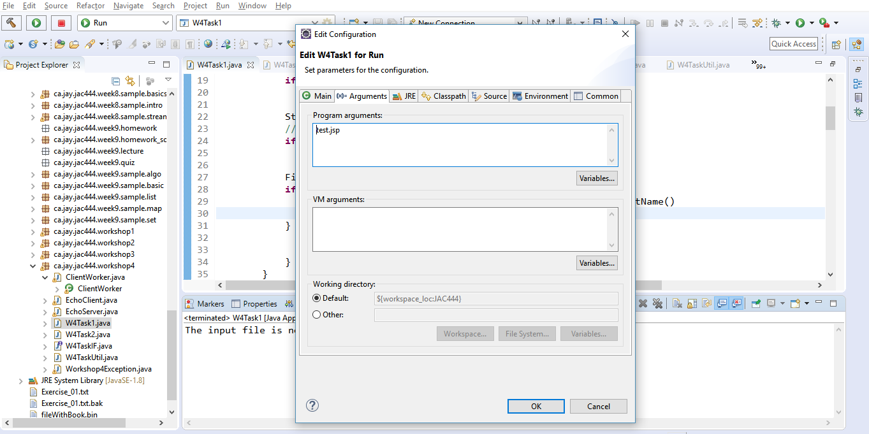
Case3. command-line argument is not .java file:
Set “test.jsp” in arguments field in IDE tool and run it
(or run “java ca.jay.jac444.workshop4.W4Task1 test.jsp” in command-line

Slide 8
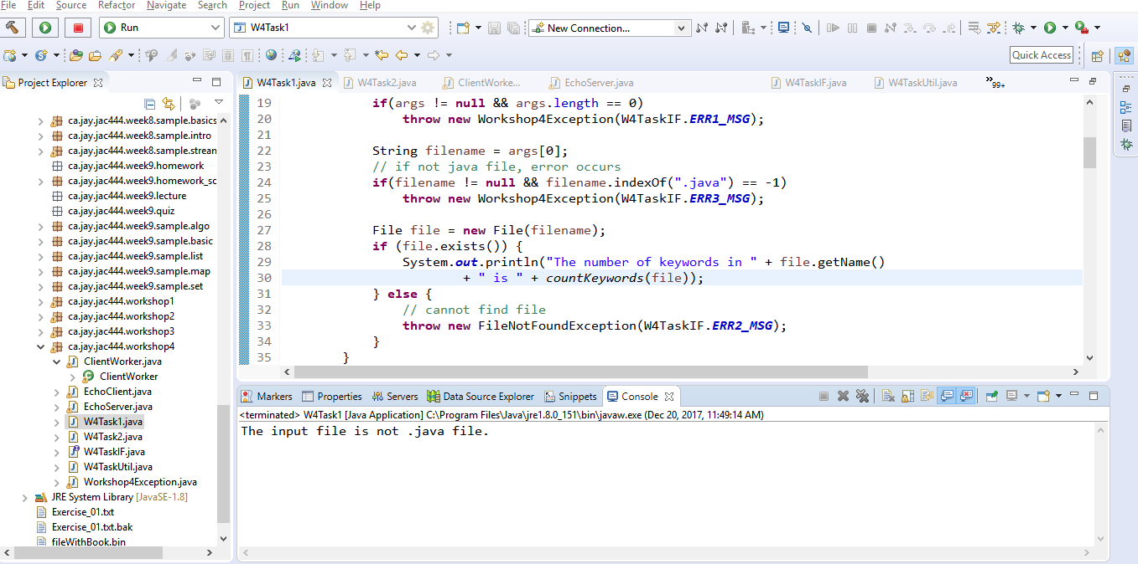
Case3. command-line argument is not .java file:
Check the error message: “The input file is not .java file.”
Error message is displayed

Slide 9
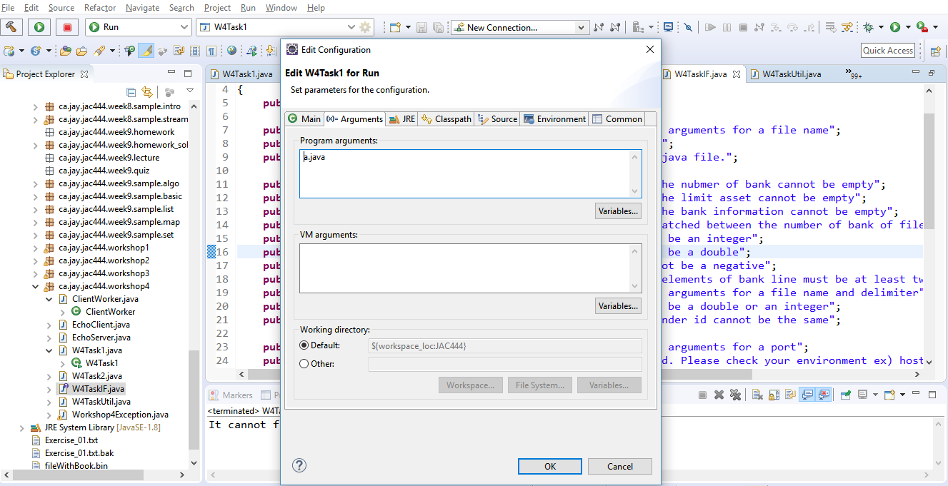
Case4. File not found:
Set “a.java” in arguments field in IDE tool and run it
(or run “java ca.jay.jac444.workshop4.W4Task1 a.java” in command-line

Slide 10
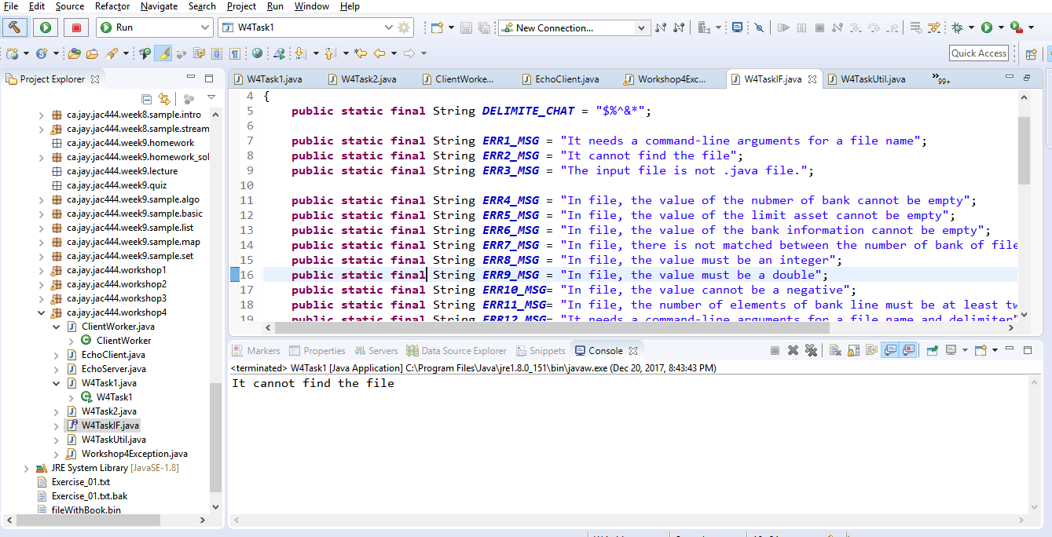
Case4. File not found:
Check the error message: “It cannot find the file”
Error message is displayed
Error message is displayed

